Slide 1
Currency Detection
Presented By :
[SHUBHANGI G. KARKHILE]
[KARISHMA S. KARAD]

Slide 2
INDEX
Project Overview
Scope
Modules
Development Tools
Pros & Cons
Applications

Slide 3
PROJECT OVERVIEW
Main problems faced by people with visual disabilities is the inability to recognize the paper currencies due to the similarity of paper texture and size between the different categories. These people face a lot of difficulty in their monetary transactions. This application can help visually impaired to recognize money. In this application blind people can speak and give command to open camera and camera will click the picture of note and tell the user by speech medium how much rupee note it is. This system uses speech to text to convert command given by blind people, Speech recognition is the interdisciplinary subfield of computational linguistics that develops methodologies and technologies that enables the recognition and translation of spoken language into text. For the result purpose this system has text to speech concept which helps to read the value of note and then it converts the text value into speech. Android allows to convert your text into voice. Not only you can convert it but it also allows you to speak text in variety of different languages.

Slide 4
SCOPE
It became too difficult for blind and visually impaired people to recognize money. Individuals with low vision need contrast colours and large fonts to identity currency note denomination. Individuals with low vision need contrast colours and large fonts to identity currency note denomination. This application will help them to recognized the value of the currency. This system uses speech to text to convert command given by blind people, Speech recognition is the interdisciplinary subfield of computational linguistics that develops methodologies and technologies that enables the recognition and translation of spoken language into text. For the result purpose this system has text to speech concept which helps to read the value of note and then it converts the text value into speech. Android allows to convert your text into voice.

Slide 5
MODULES
USER
  Currency Detection
  Dial a Contact

Slide 6

DEVELOPMENT TOOLS
ANDROID STUDIO
Android Studio is the official[7] integrated development environment (IDE) for Google's Android operating system, built on JetBrains' IntelliJ IDEA software and designed specifically for Android development.
Features:
1. Rich Layout Editor
2. Android Virtual Device
3. Quick Fixes Suggestion

Slide 7
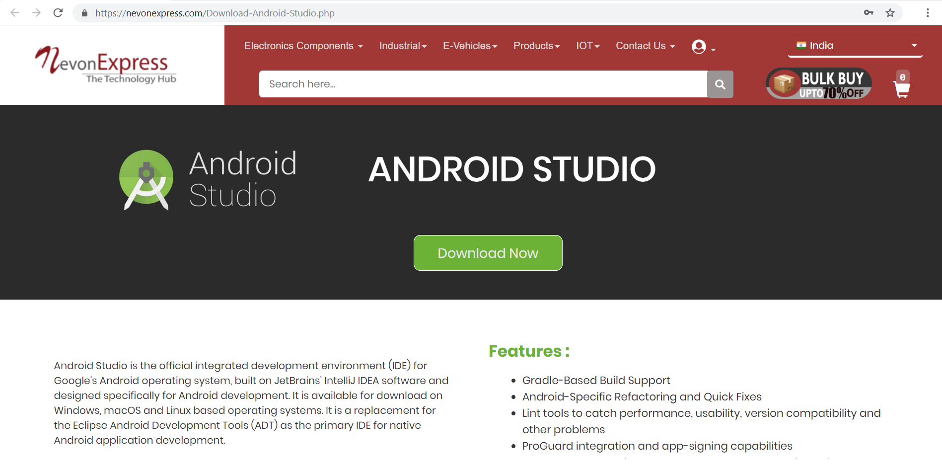
Download Android Studio
We can get Android Studio from NevonExpress.com : Visit Here

Slide 8

DEVELOPMENT TOOLS
MICROSOFT SQL SERVER
Microsoft SQL Server is a relational database management system developed by Microsoft. As a database server, it is a software product with the primary function of storing and retrieving data as requested by other. Microsoft markets at least a dozen different editions of Microsoft SQL Server, aimed at different audiences and for workloads.
Features:
1. Least Vulnerable 2. Advanced Analytics 3. Easy-to-Use

Slide 9
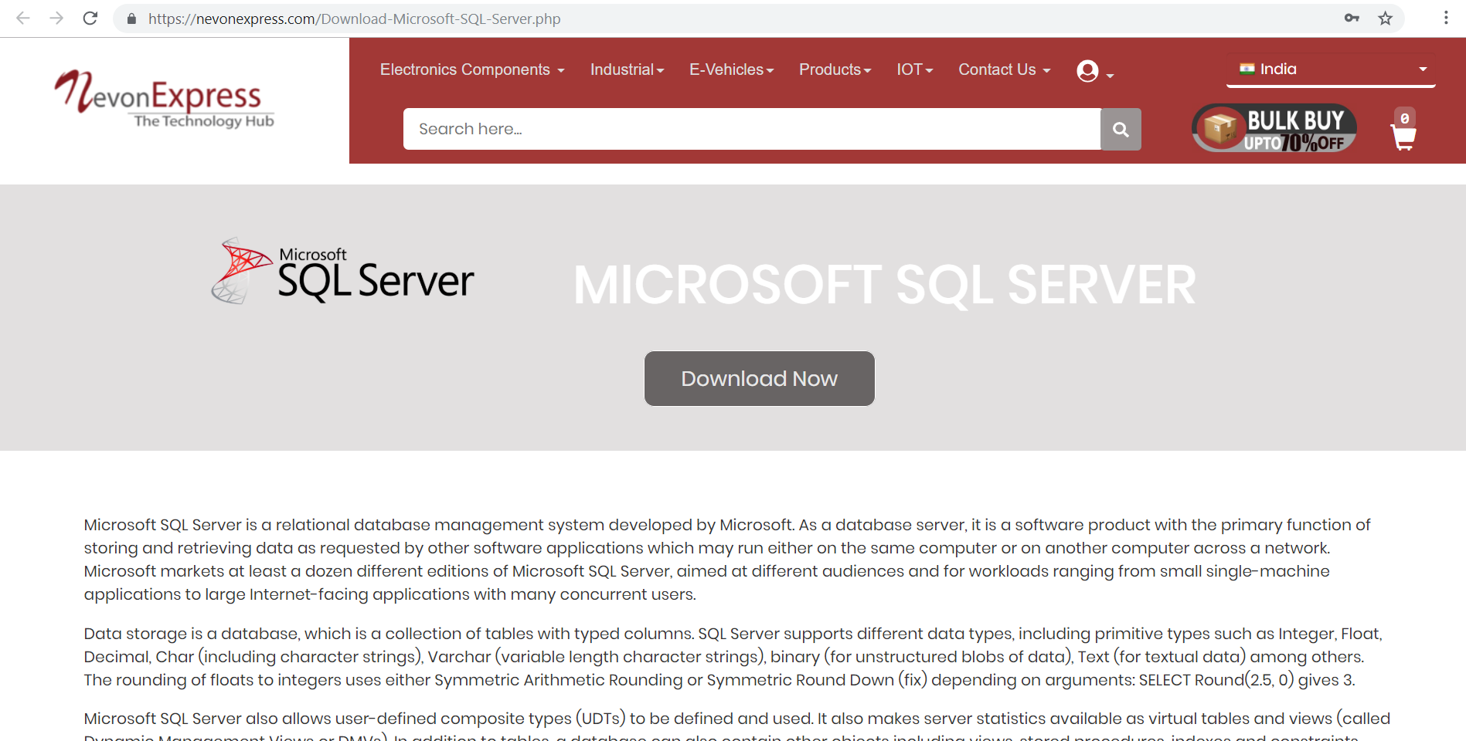
Download Microsoft SQL Server
We can get SQL Server from NevonExpress.com : Visit Here

Slide 10
PROS & CONS
Pros
This application will help blind people to know the value of the money.
Blind person can also call the person from contact by giving command.
Cons
This application requires active internet connection.
User need to put correct data or else it behaves abnormally.

Slide 11
APPLICATIONS
This particular android application can be used in mobile phone by normal as well as visually impaired people.

Slide 12
REFERENCES
en.wikipedia.org
Microsoft Developer Network (MSDN): http://msdn2.microsoft.com/en-us/default.aspx: This is a valuable online resource, and is a must for any developer using Microsoft tools.
http://www.asp.net/: This is the official Microsoft ASP.NET web site. It has a lot of: tutorials, training videos, and sample projects.

Slide 13
THANK YOU !!!

